Slide 1
23rd Lebanese Society of General Practice National Congress
The Triage & Treat Toolkit:
Your Decisive Guide to GI Symptoms
When to treat, investigate, and refer
Sarkis KHOURY M.D.
Gastroenterology, Hepatology
Notes:
Learning session for clinicians. All clinical cases are fictional teaching examples. Guidance checked September 2026. Adapt medication choices, test access, cancer pathways and referral timing to the local healthcare system. This session covers common luminal GI presentations and acute warning signs, not comprehensive hepatology or pediatric care.

Slide 2
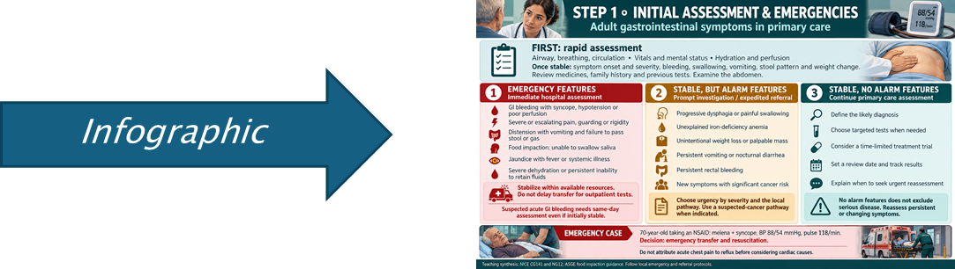
The plan for this session
1. Assess the patient
Emergencies and alarm features
2. Treat in primary care
Case 1: uncomplicated reflux
3. Investigate
Case 2: persistent watery diarrhea
4. Refer
Case 3: iron-deficiency anemia
5. Arrange follow-up
Results, referrals and reassessment
Additional dyspepsia and H. pylori guidance follows the main talk in the appendix.
Notes:
Explain the five sections. Each of the three main cases stays together. The appendix offers additional guidance if time permits.

Slide 3
Three decisions at the first visit
TREAT
A likely benign diagnosis, no alarm features, and a defined treatment trial.
INVESTIGATE
A stable patient whose symptoms need targeted tests to clarify the cause.
REFER
Alarm features, likely organic disease, or persistent symptoms despite appropriate care.
Treatment, testing and referral can occur together.
An emergency bypasses the outpatient pathway.
Notes:
Ask learners to identify the dominant next action. These are complementary clinical decisions, not mutually exclusive categories. “Explore” is expressed here as investigate. The framework is a teaching synthesis of the cited guidance.
Sources:
ACG GERD guideline (2022)
https://pubmed.ncbi.nlm.nih.gov/34807007/
AGA chronic watery diarrhea guideline (2019)
https://gastro.org/clinical-guidance/laboratory-evaluation-of-functional-diarrhea-and-diarrhea-predominant-irritable-bowel-syndrome-in-adults-ibs-d/
AGA iron-deficiency anemia guideline (2020)
https://gastro.org/clinical-guidance/gastrointestinal-evaluation-of-iron-deficiency-anemia/

Slide 4
Initial assessment
Does this patient need immediate or expedited care?
Assessment, emergency example and alarm features
Notes:
Does this patient need immediate or expedited care? Assessment, emergency example and alarm features

Slide 5
Initial assessment
History
Onset, duration, severity, stool pattern, bleeding, swallowing, vomiting and weight change.
Context
Medications, travel, family history, previous tests, cancer risk and impact on daily life.
Examination
Vitals, hydration, pallor, abdominal findings, jaundice and rectal examination when indicated.
A medication review often changes the plan: NSAIDs, anticoagulants, metformin, opioids and supplements.
NICE CG61: IBS in adults
ACG GERD guideline (2022)
Notes:
Clarify the symptom before labeling a disorder. Separate heartburn from epigastric pain, diarrhea from overflow, and dysphagia from globus. Check for non-GI causes, including cardiac disease when chest discomfort is present. A rectal examination depends on symptoms and consent.
Sources:
ACG GERD guideline (2022)
https://pubmed.ncbi.nlm.nih.gov/34807007/
NICE CG61: IBS in adults
https://www.nice.org.uk/guidance/cg61/chapter/Recommendations

Slide 6

Emergency assessment comes first
Bleeding with instability
Hematemesis or melena with syncope, hypotension, tachycardia or poor perfusion.
Acute abdominal illness
Peritonism, severe escalating pain, obstruction features or severe dehydration.
Other immediate risks
Food impaction with inability to swallow saliva, or jaundice with fever and systemic illness.
Arrange immediate hospital assessment. Stabilize within available resources without delaying transfer.
NICE CG141: acute upper GI bleeding
Notes:
This slide combines standard emergency triage with acute GI bleeding guidance. ABC assessment and emergency transport take priority. Suspected obstruction or peritonitis may need surgical care. Fever, jaundice and abdominal pain suggest cholangitis and require urgent hospital treatment. Acute chest pain requires assessment for cardiac causes.
Sources:
NICE CG141: acute upper GI bleeding
https://www.nice.org.uk/guidance/cg141/chapter/Recommendations

Slide 7
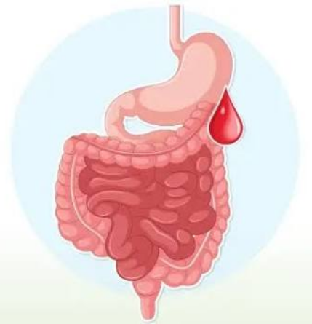
Emergency example: melena and syncope
A 70-year-old taking an NSAID develops black tarry stools and fainting.
BP 88/54 mmHg, pulse 118/min, pale and clammy.
This patient needs emergency hospital transfer and resuscitation.
Do not wait for outpatient blood tests or a routine endoscopy appointment.
Hospital endoscopy follows initial resuscitation, urgently in an unstable severe bleed.
NICE CG141: acute upper GI bleeding
Notes:
Fictional emergency case. Assess airway, breathing and circulation. Call emergency transport and initiate supportive care within training and resources. Review anticoagulant and antiplatelet use and communicate it to the receiving team. A normal early hemoglobin cannot reliably exclude significant acute blood loss.
Sources:
NICE CG141: acute upper GI bleeding
https://www.nice.org.uk/guidance/cg141/chapter/Recommendations

Slide 8

Alarm features in a stable patient
Progressive dysphagia or painful swallowing
Unexplained GI bleeding or iron-deficiency anemia
Unintentional weight loss, palpable mass or persistent vomiting
Persistent nocturnal diarrhea or inflammatory features
New symptoms with substantial age-related or family cancer risk
An alarm feature changes the pathway. Its urgency depends on the symptom and clinical context.
ACG/CAG dyspepsia guideline (2017)
NICE NG12: suspected cancer referral
Notes:
Use local suspected-cancer pathways. Dysphagia merits urgent assessment. Age thresholds differ across countries and presenting syndromes. An isolated alarm feature in a younger person with dyspepsia does not automatically mandate endoscopy under ACG/CAG guidance, but severe, multiple or progressive findings lower the threshold. Avoid reassuring a patient solely on the basis of young age.
Sources:
NICE NG12: suspected cancer referral
https://www.nice.org.uk/guidance/ng12/chapter/recommendations-organised-by-site-of-cancer
ACG/CAG dyspepsia guideline (2017)
https://pubmed.ncbi.nlm.nih.gov/28631728/

Slide 9
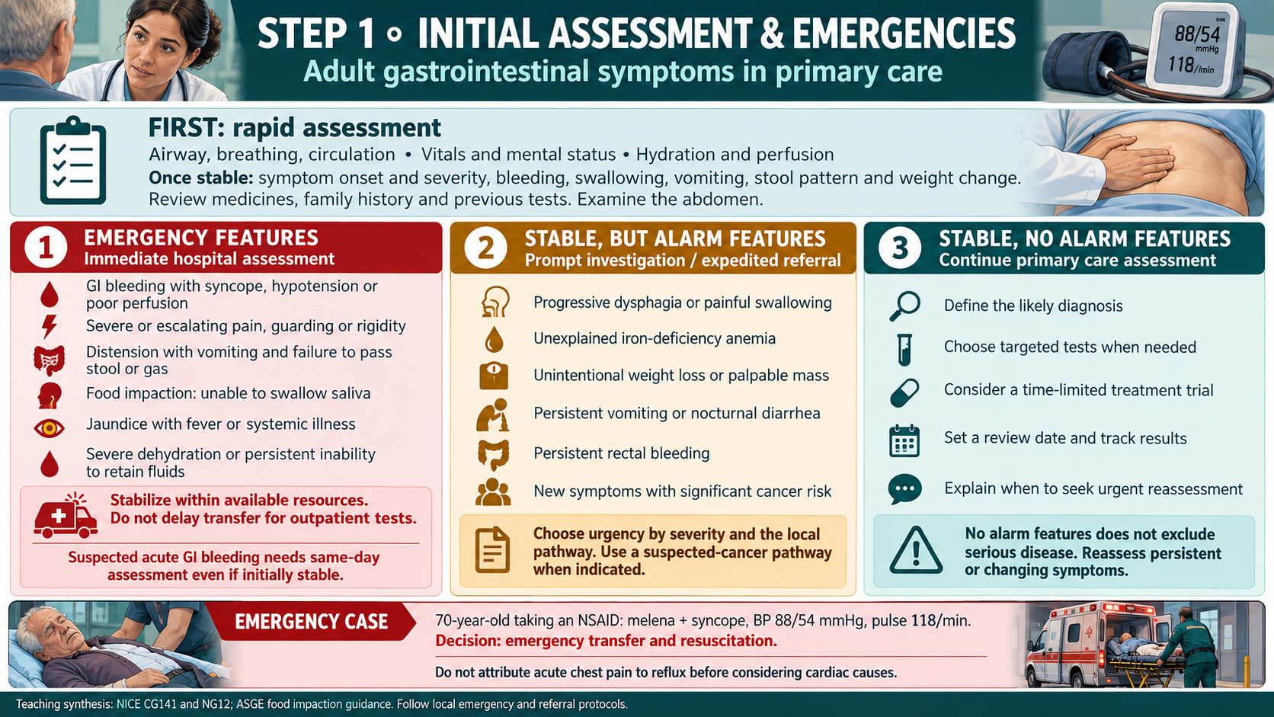

Slide 10
When to treat
Can this patient start treatment in primary care?
Case 1: reflux presentation, treatment and review
Notes:
Can this patient start treatment in primary care? Case 1: reflux presentation, treatment and review

Slide 11
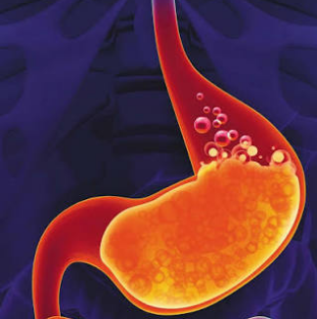
Case 1: heartburn after meals
What is the most appropriate next step?
A 34-year-old has 6 weeks of heartburn and acid regurgitation, worse after late meals.
No dysphagia, weight loss, vomiting, bleeding or exertional chest pain.
Examination is normal. No major Barrett’s esophagus risk profile.
Treat now, order endoscopy, or refer?
ACG GERD guideline (2022)
Notes:
Fictional case. Pause for discussion. Expected answer: a primary care treatment trial for typical uncomplicated reflux. Confirm that chest symptoms do not suggest a cardiac cause. Routine initial endoscopy is unnecessary in this low-risk presentation.
Sources:
ACG GERD guideline (2022)
https://pubmed.ncbi.nlm.nih.gov/34807007/

Slide 12
Case 1: treatment in primary care
Treatment
A standard-dose PPI once daily, 30–60 minutes before breakfast, for 8 weeks.
Lifestyle
Avoid meals within 2–3 hours of bedtime. Address weight if appropriate and individual triggers.
Review
Assess adherence and response. If controlled, attempt withdrawal or step down when appropriate.
New dysphagia or bleeding changes the plan immediately.
ACG GERD guideline (2022)
Notes:
PPI means proton pump inhibitor. A standard-dose option is omeprazole 20 mg once daily, adjusted for individual contraindications and interactions. Check symptoms during the trial and formally reassess at 8 weeks. Failure despite correct use, or recurrence on withdrawal, warrants further evaluation, often endoscopy. Long-term maintenance may be appropriate for established complications and should not be stopped indiscriminately.
Sources:
ACG GERD guideline (2022)
https://pubmed.ncbi.nlm.nih.gov/34807007/

Slide 13
Other presentations suitable for initial treatment
Constipation without alarms
Review causes, offer gradual soluble fiber and adequate fluids. Polyethylene glycol is an evidence-based option.
Established IBS without alarms
Explain the diagnosis. Match diet and symptom treatment to the bowel pattern.
A clear follow-up plan
Record the target symptom, review date and reason to escalate.
An empiric treatment trial needs a stop point and reassessment.
AGA/ACG constipation guideline (2023)
AGA refractory constipation update (2026)
NICE CG61: IBS in adults
Notes:
IBS is irritable bowel syndrome. A positive diagnosis requires a compatible history and appropriate limited assessment, not simply a normal abdominal examination. Consider dietitian support for restrictive diets. Constipation with obstruction symptoms is not suitable for empiric laxative management. Persistent difficult evacuation or failure of adequate treatment can warrant GI evaluation and anorectal testing.
Sources:
AGA/ACG constipation guideline (2023)
https://gastro.org/clinical-guidance/pharmacological-management-of-chronic-idiopathic-constipation-cic/
AGA refractory constipation update (2026)
https://gastro.org/clinical-guidance/evaluation-and-management-of-refractory-constipation/
NICE CG61: IBS in adults
https://www.nice.org.uk/guidance/cg61/chapter/Recommendations

Slide 14
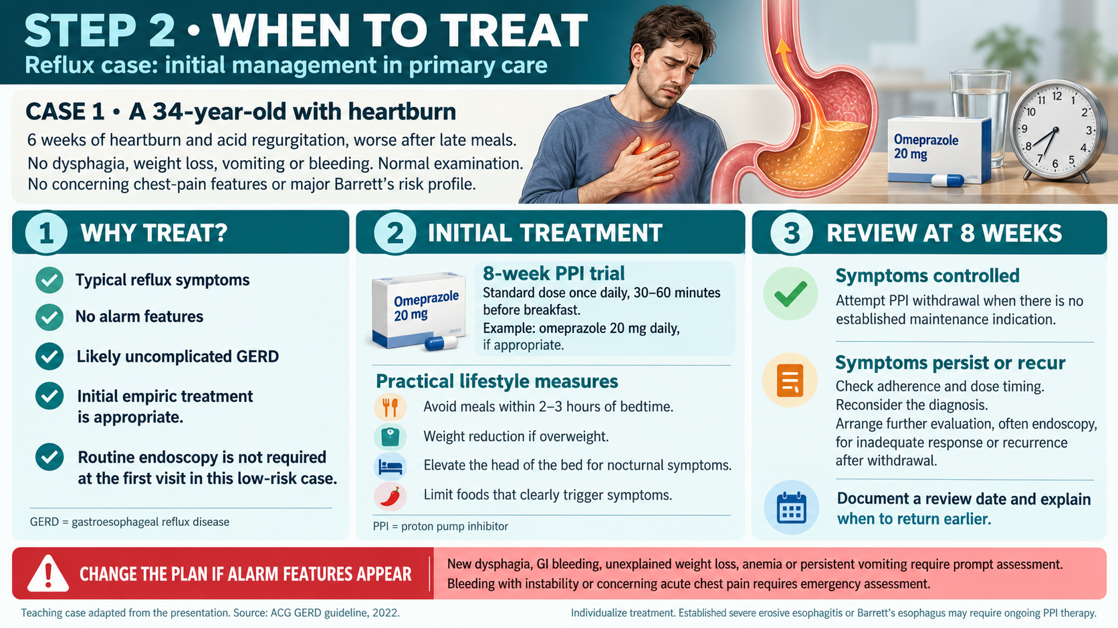

Slide 15
When to investigate
Which tests will clarify the cause and change management?
Case 2: diarrhea presentation, tests and next steps
Notes:
Which tests will clarify the cause and change management? Case 2: diarrhea presentation, tests and next steps

Slide 16

Investigation should answer a clinical question
Epigastric pain
Could this be H. pylori-associated dyspepsia or an indication for endoscopy?
Persistent diarrhea
Is there inflammation, celiac disease, infection or another treatable cause?
Anemia or bleeding
Is there a source that requires endoscopic evaluation?
Order tests that change management. Complete broad testing should not be a condition for referral.
ACG/CAG dyspepsia guideline (2017)
AGA chronic watery diarrhea guideline (2019)
AGA iron-deficiency anemia guideline (2020)
Notes:
The examples are deliberately selective. CBC, chemistry, inflammatory tests, imaging and endoscopy depend on the clinical question. Avoid indiscriminate panels and repeated normal tests without revisiting the diagnosis.
Sources:
ACG/CAG dyspepsia guideline (2017)
https://pubmed.ncbi.nlm.nih.gov/28631728/
AGA chronic watery diarrhea guideline (2019)
https://gastro.org/clinical-guidance/laboratory-evaluation-of-functional-diarrhea-and-diarrhea-predominant-irritable-bowel-syndrome-in-adults-ibs-d/
AGA iron-deficiency anemia guideline (2020)
https://gastro.org/clinical-guidance/gastrointestinal-evaluation-of-iron-deficiency-anemia/

Slide 17

Case 2: persistent watery diarrhea
Which tests would change management?
A 29-year-old has 8 weeks of watery stools, 4–5 times daily, with bloating.
No blood, weight loss, fever or nocturnal symptoms. Vitals and examination are normal.
No recent antibiotics, high-risk travel or family history of IBD, celiac disease or colorectal cancer.
Stable does not mean “no investigation needed.”
AGA chronic watery diarrhea guideline (2019)
Notes:
Fictional case. Ask the audience for a limited first-line work-up. Review medications, diet and exposure history before ordering tests. Chronic watery diarrhea lasts at least 4 weeks. Do not diagnose IBS solely because the patient is young. IBS also requires a characteristic recurrent abdominal pain pattern.
Sources:
AGA chronic watery diarrhea guideline (2019)
https://gastro.org/clinical-guidance/laboratory-evaluation-of-functional-diarrhea-and-diarrhea-predominant-irritable-bowel-syndrome-in-adults-ibs-d/

Slide 18
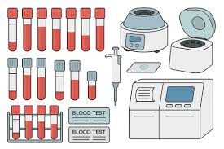
Case 2: a targeted initial work-up
Blood tests
CBC and chemistry as clinically indicated. Tissue transglutaminase IgA with total IgA.
Stool tests
Fecal calprotectin or lactoferrin, plus Giardia testing. Add other infection tests when indicated.
Interpretation
Positive celiac serology or inflammatory findings warrant specialist evaluation.
Keep gluten in the diet during celiac testing. IgA deficiency needs an appropriate IgG-based test.
AGA chronic watery diarrhea guideline (2019)
Notes:
The AGA functional diarrhea guideline applies to immunocompetent adults with watery diarrhea without alarm features. It supports Giardia and celiac testing and fecal inflammatory markers. Do not use normal CRP or ESR alone to exclude IBD. Do not routinely order ova and parasite panels other than Giardia in patients without relevant travel or exposure. Consider bile acid diarrhea testing if symptoms persist. Basic blood tests assess anemia, electrolyte disturbance or other clues according to presentation.
Sources:
AGA chronic watery diarrhea guideline (2019)
https://gastro.org/clinical-guidance/laboratory-evaluation-of-functional-diarrhea-and-diarrhea-predominant-irritable-bowel-syndrome-in-adults-ibs-d/

Slide 19
Case 2: how the results change the pathway
Reassuring results
Reassess symptoms and medicines. Consider functional diarrhea or IBS when criteria fit.
Positive celiac serology
Refer for diagnostic confirmation. Avoid a gluten-free diet before confirmation.
Persistent or abnormal findings
Refer for further evaluation, which may include colonoscopy and biopsies.
Calprotectin is not a cancer test. A normal result does not exclude every organic cause of diarrhea.
AGA chronic watery diarrhea guideline (2019)
NICE CG61: IBS in adults
Notes:
Fictional case branches, not observed outcomes. Use the assay and local pathway to interpret calprotectin. Infection and NSAIDs may raise it. Persistent watery diarrhea can reflect microscopic colitis despite a normal-looking colon and requires biopsies when investigated. Ongoing symptoms can also reflect bile acid diarrhea. Refer earlier if weight loss, blood, anemia or deterioration appears.
Sources:
AGA chronic watery diarrhea guideline (2019)
https://gastro.org/clinical-guidance/laboratory-evaluation-of-functional-diarrhea-and-diarrhea-predominant-irritable-bowel-syndrome-in-adults-ibs-d/
NICE CG61: IBS in adults
https://www.nice.org.uk/guidance/cg61/chapter/Recommendations

Slide 20
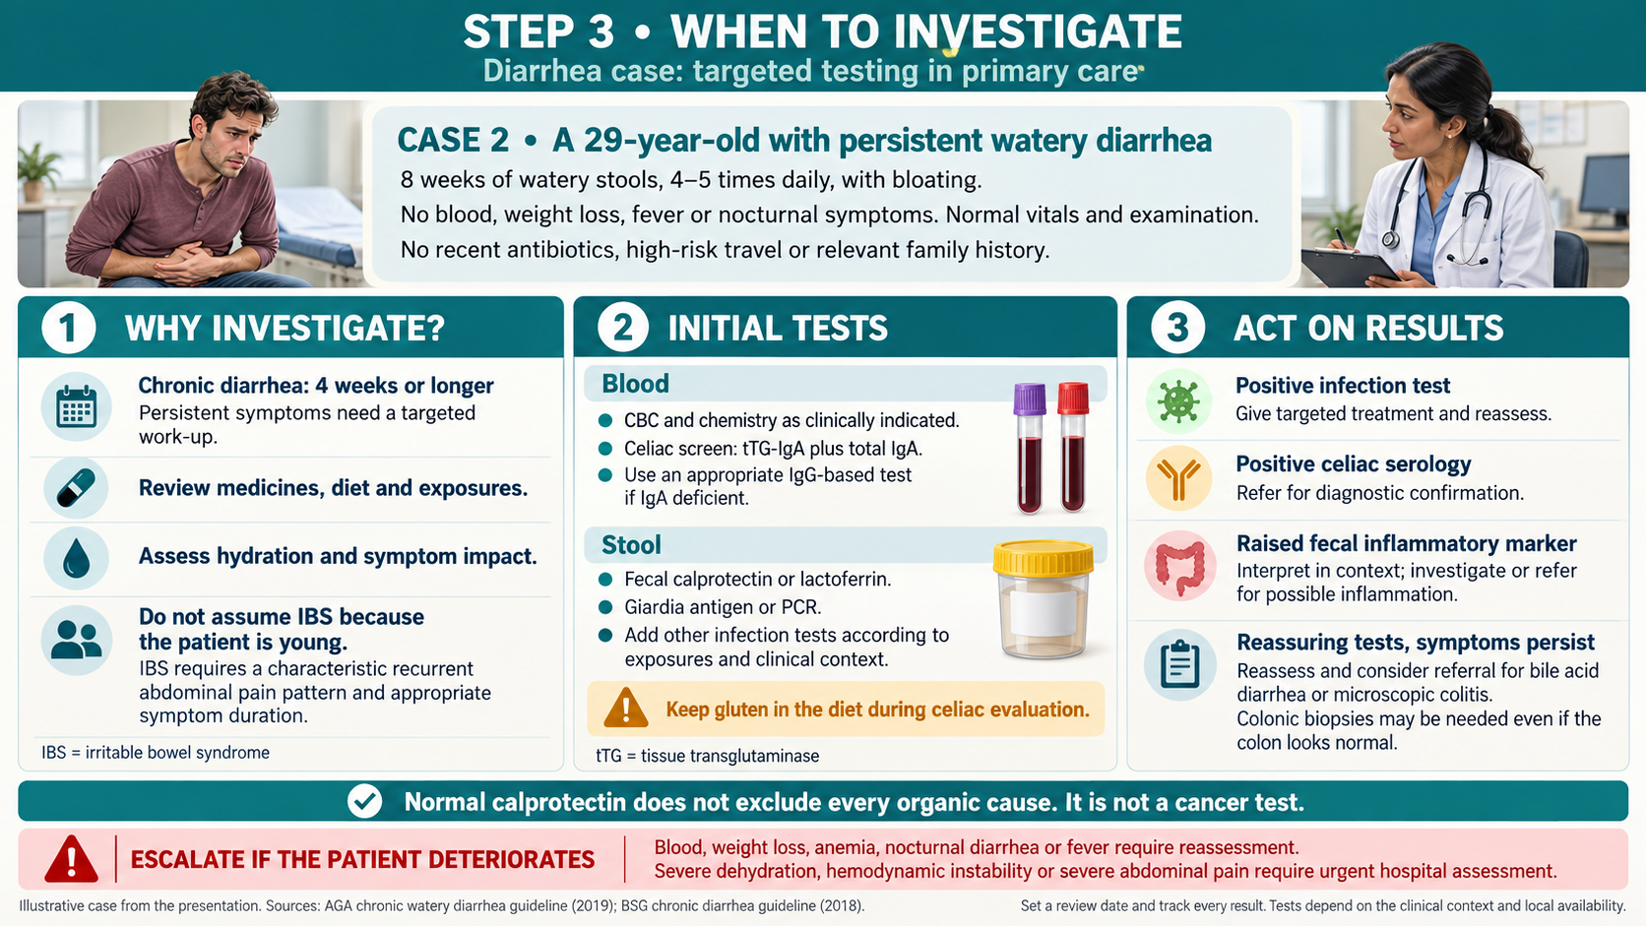

Slide 21
When to refer
Does this patient need a specialist, and how urgently?
Case 3: anemia presentation, referral and parallel care
Notes:
Does this patient need a specialist, and how urgently? Case 3: anemia presentation, referral and parallel care

Slide 22

Referral urgency
Emergency
Instability, severe acute bleeding, peritonitis, obstruction or inability to swallow saliva.
Urgent / expedited
Progressive dysphagia, suspected cancer, concerning anemia or probable active inflammatory disease.
Routine
Persistent symptoms despite appropriate care, diagnostic uncertainty or a need for specialist testing.
State the urgency and reason. Use the local pathway rather than a universal waiting-time target.
NICE NG12: suspected cancer referral
AGA iron-deficiency anemia guideline (2020)
NICE CG141: acute upper GI bleeding
Notes:
These categories are a teaching synthesis. Anemia urgency depends on severity, symptoms, hemodynamic status and concern for malignancy. Severe colitis or systemic toxicity requires same-day hospital assessment. Mild, stable suspected IBD still needs timely specialist evaluation. A routine referral should not interrupt active safety-netting.
Sources:
NICE NG12: suspected cancer referral
https://www.nice.org.uk/guidance/ng12/chapter/recommendations-organised-by-site-of-cancer
AGA iron-deficiency anemia guideline (2020)
https://gastro.org/clinical-guidance/gastrointestinal-evaluation-of-iron-deficiency-anemia/
NICE CG141: acute upper GI bleeding
https://www.nice.org.uk/guidance/cg141/chapter/Recommendations

Slide 23
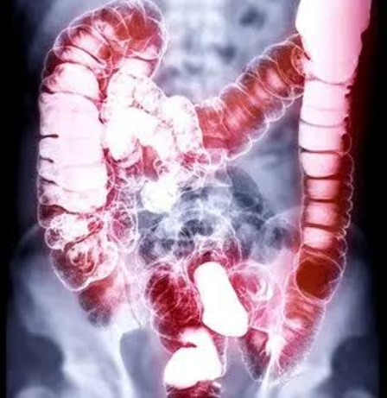
Case 3: anemia with a bowel habit change
Is iron replacement alone enough?
A 62-year-old man reports fatigue and 2 months of altered bowel habit.
Hemoglobin 9.8 g/dL, MCV 72 fL, ferritin 8 ng/mL.
He is stable and has no visible rectal bleeding.
The absence of visible blood does not remove the need for GI evaluation.
AGA iron-deficiency anemia guideline (2020)
NICE NG12: suspected cancer referral
Notes:
Fictional case. The anemia is clearly iron deficient in this example. Ask learners to identify the appropriate referral and investigations. Occult gastrointestinal blood loss must be considered. Iron therapy and etiologic investigation can proceed together.
Sources:
AGA iron-deficiency anemia guideline (2020)
https://gastro.org/clinical-guidance/gastrointestinal-evaluation-of-iron-deficiency-anemia/
NICE NG12: suspected cancer referral
https://www.nice.org.uk/guidance/ng12/chapter/recommendations-organised-by-site-of-cancer

Slide 24

Case 3: expedited referral and parallel care
Refer
Use an expedited GI or suspected-cancer pathway for unexplained IDA with bowel change.
Investigate
Bidirectional endoscopy is usually indicated in men with unexplained IDA.
Treat and track
Start appropriate iron replacement. Monitor clinical status and ensure referral completion.
Improvement in hemoglobin does not establish the source of iron loss.
AGA iron-deficiency anemia guideline (2020)
NICE NG12: suspected cancer referral
Notes:
Bidirectional endoscopy means upper endoscopy and colonoscopy. AGA recommends it for men and postmenopausal women with unexplained iron-deficiency anemia. Menstrual blood loss changes the assessment in premenopausal women, but persistent, disproportionate anemia or GI alarms still warrants evaluation. Under NICE, FIT guides colorectal referral, with 10 micrograms Hb/g feces as the referral threshold. Low FIT does not justify delaying referral when concern persists and does not evaluate upper GI causes. Follow local practice.
Sources:
AGA iron-deficiency anemia guideline (2020)
https://gastro.org/clinical-guidance/gastrointestinal-evaluation-of-iron-deficiency-anemia/
NICE NG12: suspected cancer referral
https://www.nice.org.uk/guidance/ng12/chapter/recommendations-organised-by-site-of-cancer

Slide 25

A useful gastroenterology referral
The clinical question and requested urgency
Symptom timeline, weight trend, alarm features and relevant examination
Laboratory results with dates, imaging and previous endoscopy reports
Treatment tried, dose, duration, adherence and response
Family history, relevant medicines and anticoagulant use
Name who will follow outstanding results and confirm that the patient attends.
Suggested referral structure, not a mandated guideline format. Example: “Urgent assessment for unexplained iron-deficiency anemia with new bowel change. Stable 62-year-old man. Hb 9.8 g/dL, ferritin 8 ng/mL. Please assess for upper and lower GI sources.” Include reliable patient contact details in the actual referral. Never include invented identifiers from a teaching case.
Notes:
Suggested referral structure, not a mandated guideline format. Example: “Urgent assessment for unexplained iron-deficiency anemia with new bowel change. Stable 62-year-old man. Hb 9.8 g/dL, ferritin 8 ng/mL. Please assess for upper and lower GI sources.” Include reliable patient contact details in the actual referral. Never include invented identifiers from a teaching case.

Slide 26
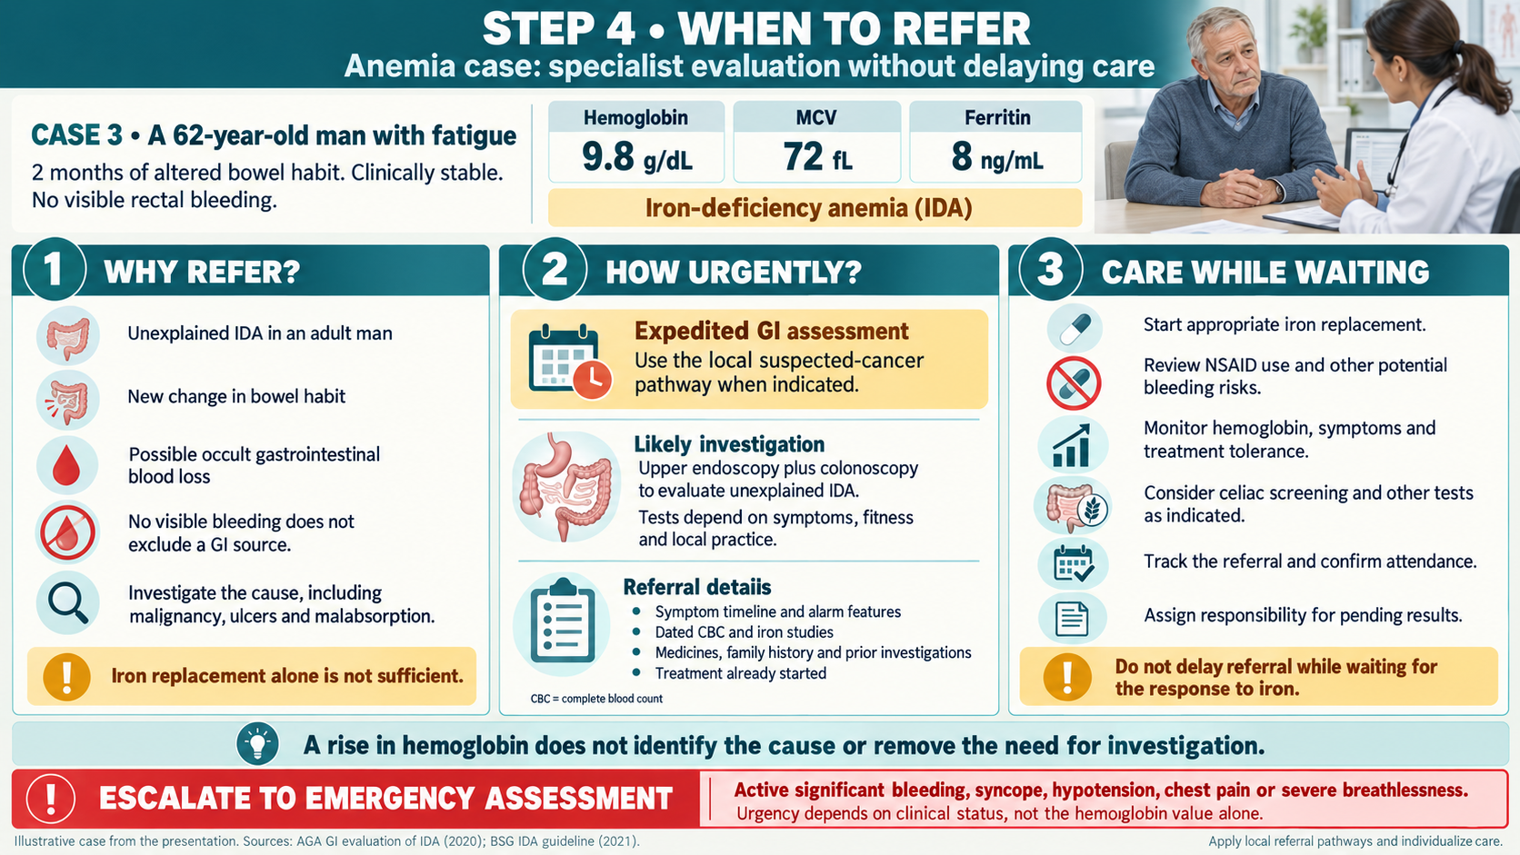

Slide 27
Follow-up and review
Who will check the results and reassess the patient?
Follow-up responsibilities and the three main decisions
Notes:
Who will check the results and reassess the patient? Follow-up responsibilities and the three main decisions

Slide 28
Safety-netting at every decision
A review date
Set a specific follow-up point and the expected treatment response.
An escalation plan
Explain what requires earlier review or immediate emergency care.
Ownership
Track test results and referrals. Reconsider the diagnosis if symptoms persist.
“Come back if needed” is not a complete follow-up plan.
NICE CG61: IBS in adults
NICE NG12: suspected cancer referral
Notes:
Ask patients to repeat the plan in their own words. Give written advice where useful. New dysphagia, visible bleeding, melena, progressive weight loss, inability to maintain intake or deterioration require reassessment. A patient with an initially benign diagnosis can develop new disease.
Sources:
NICE CG61: IBS in adults
https://www.nice.org.uk/guidance/cg61/chapter/Recommendations
NICE NG12: suspected cancer referral
https://www.nice.org.uk/guidance/ng12/chapter/recommendations-organised-by-site-of-cancer

Slide 29
The three cases: the next action
TREAT
Typical uncomplicated reflux: a defined PPI trial, lifestyle advice and review.
INVESTIGATE
Stable persistent watery diarrhea: targeted tests, then act on the results.
REFER
Unexplained iron-deficiency anemia with bowel change: expedited etiologic assessment.
Instability or acute severe illness always takes priority over the outpatient plan.
ACG GERD guideline (2022)
AGA chronic watery diarrhea guideline (2019)
AGA iron-deficiency anemia guideline (2020)
NICE CG141: acute upper GI bleeding
Notes:
Close by asking learners which single finding would change each initial decision. Suggested answers: new dysphagia in Case 1, bloody diarrhea with systemic illness in Case 2, or hemodynamic instability in Case 3. These cases illustrate the dominant action. Treatment and testing often continue while referral proceeds.
Sources:
ACG GERD guideline (2022)
https://pubmed.ncbi.nlm.nih.gov/34807007/
AGA chronic watery diarrhea guideline (2019)
https://gastro.org/clinical-guidance/laboratory-evaluation-of-functional-diarrhea-and-diarrhea-predominant-irritable-bowel-syndrome-in-adults-ibs-d/
AGA iron-deficiency anemia guideline (2020)
https://gastro.org/clinical-guidance/gastrointestinal-evaluation-of-iron-deficiency-anemia/
NICE CG141: acute upper GI bleeding
https://www.nice.org.uk/guidance/cg141/chapter/Recommendations

Slide 30
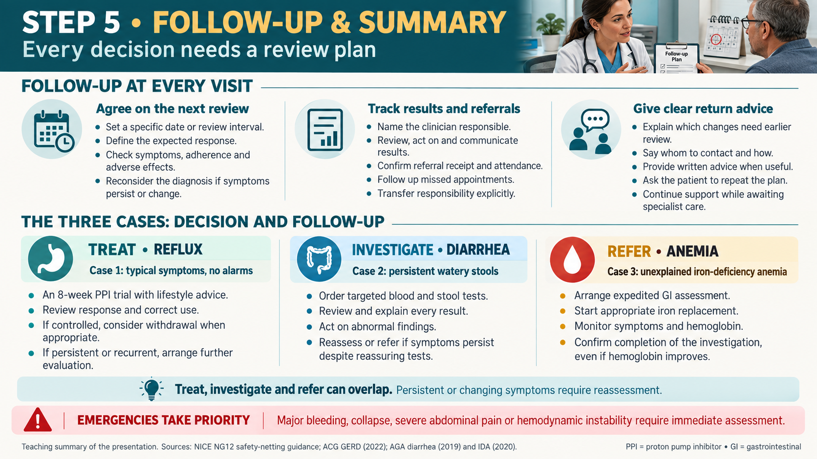

Slide 31
Additional clinical guidance
Dyspepsia and H. pylori
Optional material after the main talk, followed by references
Notes:
Dyspepsia and H. pylori Optional material after the main talk, followed by references

Slide 32
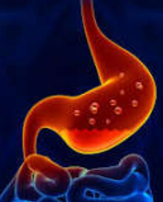
Dyspepsia: initial investigation
For lower-risk patients under 60: noninvasive H. pylori testing and treatment if positive.
Use a urea breath test or stool antigen test for active infection.
New dyspepsia at age 60 or older generally warrants endoscopy under ACG/CAG guidance.
Consider earlier endoscopy for elevated gastric cancer risk or concerning features.
The age threshold is guideline-specific. Follow the local cancer pathway.
ACG/CAG dyspepsia guideline (2017)
ACG/CAG dyspepsia guideline (2017)
Notes:
Dyspepsia refers to epigastric pain or burning, early satiety or postprandial fullness. If H. pylori is negative or symptoms persist after eradication, a PPI trial is appropriate in lower-risk patients. Hold PPIs for 2 weeks and antibiotics/bismuth for 4 weeks before active-infection testing where feasible to avoid false negatives. High-risk background or family history may justify earlier endoscopy.
Sources:
ACG/CAG dyspepsia guideline (2017)
https://pubmed.ncbi.nlm.nih.gov/28631728/
ACG/CAG dyspepsia guideline (2017)
https://gi.org/journals-publications/ebgi/schoenfeld_sep2024/

Slide 33
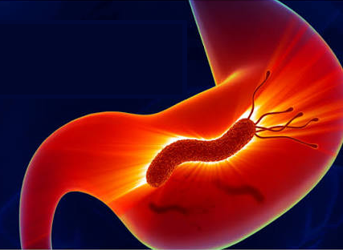
H. pylori: treatment includes proof of cure
Choose an effective regimen
Use local resistance guidance, prior antibiotic exposure, allergies and availability.
Avoid a common error
Do not use empiric clarithromycin triple therapy without proven susceptibility.
Confirm eradication
Breath or stool antigen testing at least 4 weeks after treatment. Hold PPI for 2 weeks.
Bismuth and antibiotics need a 4-week washout before the test of cure.
ACG H. pylori guidance (2024)
Notes:
The 2024 ACG guideline recommends optimized bismuth quadruple therapy for 14 days when susceptibility is unknown. Other recommended options depend on patient factors and availability. Do not select a regimen from symptom response alone. Serology is unsuitable to confirm eradication. Persistent infection after treatment requires review of adherence and prior antibiotics, often with specialist input.
Sources:
ACG H. pylori guidance (2024)
https://gi.org/journals-publications/ebgi/schoenfeld_sep2024/

Slide 34

For your ASSISTANCE

